Slide 1

Clean Code & Design Patterns
July 26, 2022

Slide 2
Contents
01
02
03
04
05
06
07
08
09
Introduction to Clean code
SOLID
Code smells
Introduction to Design Patterns
Classification
Creational design patterns
Structural design patterns
Behavioral design patterns
Q&A

Slide 3
Clean code

Slide 4

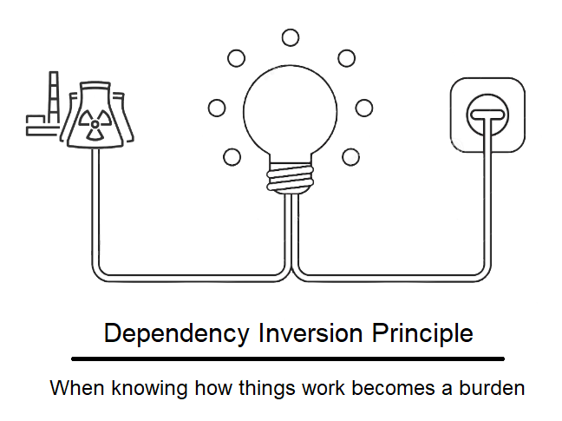
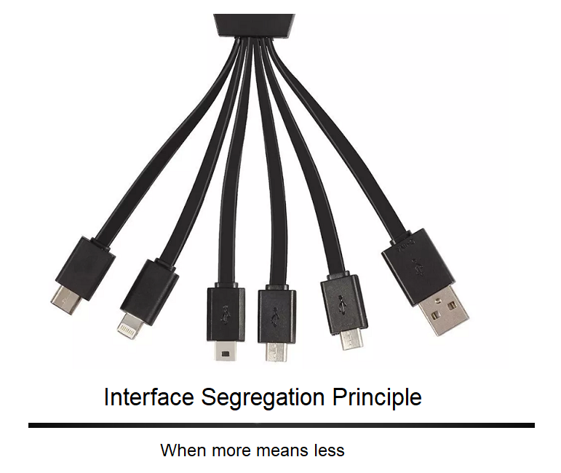

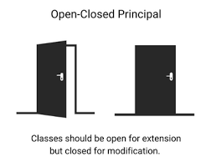
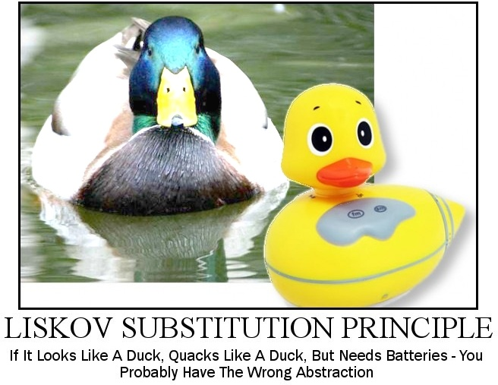
Single Responsibility
Open-Closed
SOLID
Liskov Substitution
Interface Segregation
Dependency Inversion

Slide 5


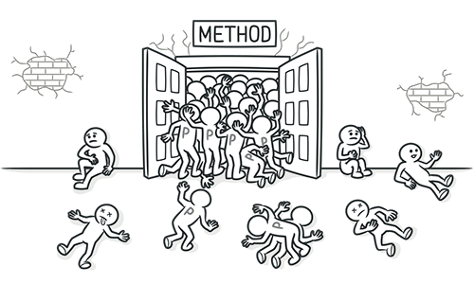
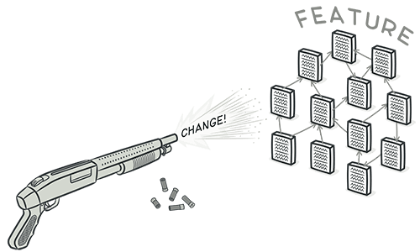
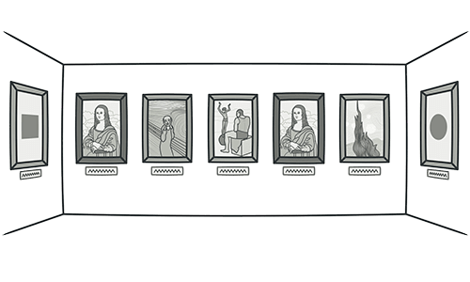
God objects
Long methods
Code Smells
Long parameter list
Shotgun surgery
Duplicate code

Slide 6
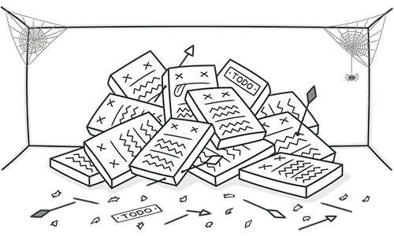
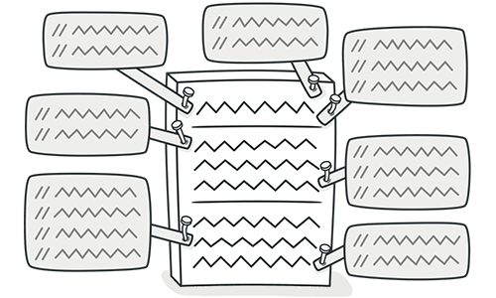
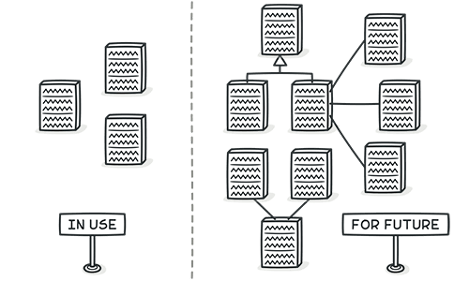
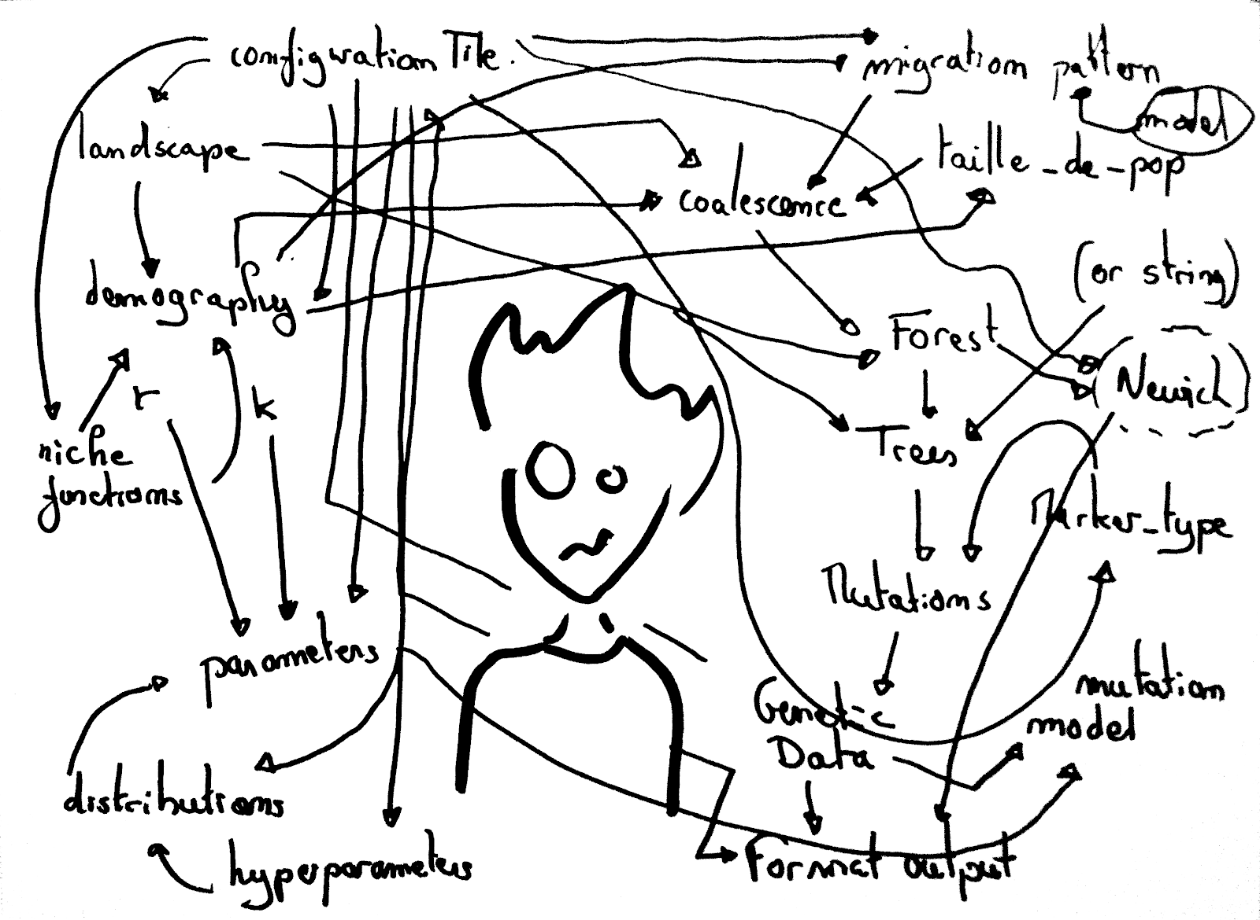
Dead code
Comments
Code Smells
Speculative generality
Spaghetti code

Slide 7
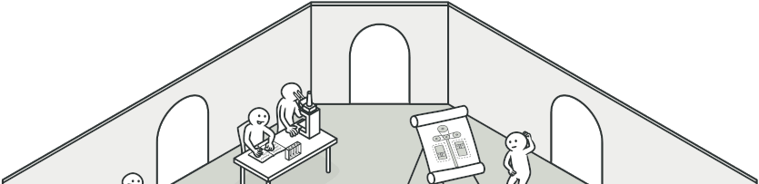
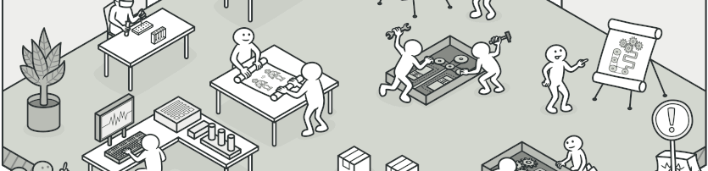

What is a Design Pattern?

Slide 8



Creational
Creational patterns provide object creation mechanisms that increase flexibility and reuse of existing code.
Classification of patterns
Structural
Structural patterns explain how to assemble objects and classes into larger structures, while keeping these structures flexible and efficient.
Behavioral
Behavioural patterns take care of effective communication and the assignment of responsibilities between objects.

Slide 9
Creational design patterns

Slide 10
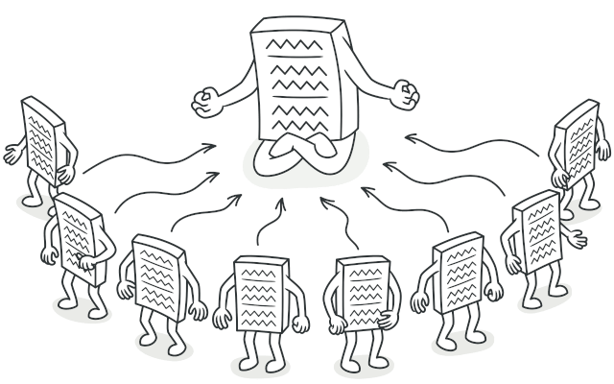
Singleton pattern

Slide 11
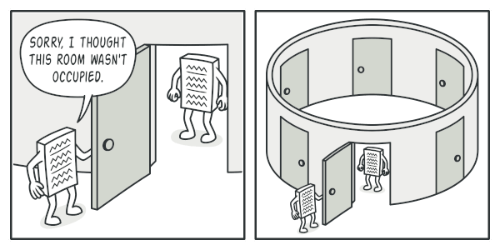
Singleton is a creational design pattern that lets you ensure that a class has only one instance, while providing a global access point to this instance.

Slide 12

Implementation
Add a private static field to the class for storing the singleton instance.
Declare a public static creation method for getting the singleton instance.
Implement “lazy initialization” inside the static method. It should create a new object on its first call and put it into the static field. The method should always return that instance on all subsequent calls.
Make the constructor of the class private. The static method of the class will still be able to call the constructor, but not the other objects.
Go over the client code and replace all direct calls to the singleton’s constructor with calls to its static creation method.

Slide 13
Pros and cons
You can be sure that a class has only a single instance.
You gain a global access point to that instance.
The singleton object is initialized only when it’s requested for the first time.
Violates the Single Responsibility Principle. The pattern solves two problems at the time.
The Singleton pattern can mask bad design, for instance, when the components of the program know too much about each other.
The pattern requires special treatment in a multithreaded environment so that multiple threads won’t create a singleton object several times.
It may be difficult to unit test the client code of the Singleton because many test frameworks rely on inheritance when producing mock objects. Since the constructor of the singleton class is private and overriding static methods is impossible in most languages, you will need to think of a creative way to mock the singleton. Or just don’t write the tests. Or don’t use the Singleton pattern.

Slide 14
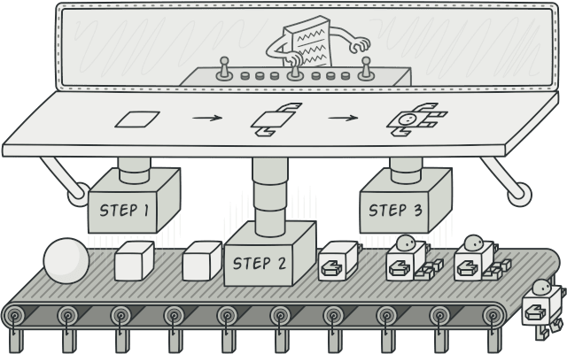
Builder pattern

Slide 15
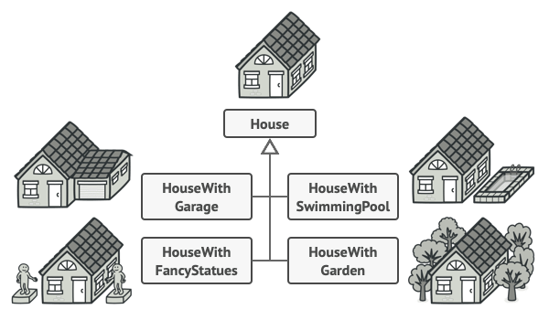
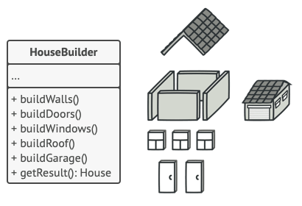
Builder is a creational design pattern that lets you construct complex objects step by step. The pattern allows you to produce different types and representations of an object using the same construction code.

Slide 16
Implementation
Create a static class named Builder inside the main class.
Create an instance of the main class inside the builder class.
Implement a different method inside the inner class for each attribute of the main class. The method should set the value for a specific attribute of the main class instance and return the builder instance. It is considered a best practice to name each method the same as the parameter that the method is setting.
Implement a method named build in which to return the builder instance.
Implement a static method named builder which returns a new instance of the builder inner class if you want to achieve the same implementation as the one used in Lombok.

Slide 17
Pros and cons
You can construct objects step-by-step, defer construction steps or run steps recursively.
You can reuse the same construction code when building various representations of products.
Single Responsibility Principle. You can isolate complex construction code from the business logic of the product.
The overall complexity of the code increases since the pattern requires creating a inner lass.

Slide 18
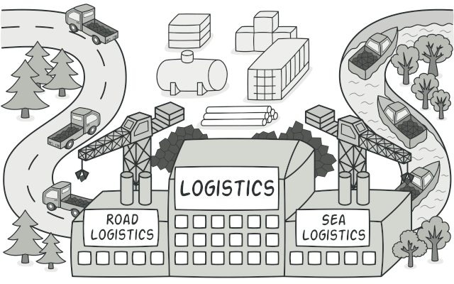
Factory method

Slide 19
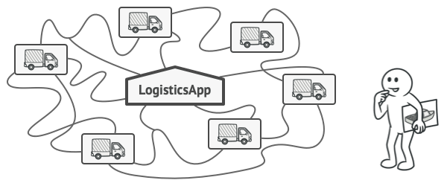
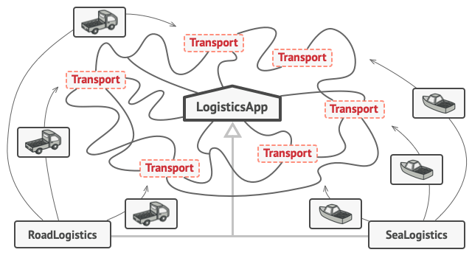
Factory Method is a creational design pattern that provides an interface for creating objects in a superclass, but allows subclasses to alter the type of objects that will be created.

Slide 20
Implementation
Make all products follow the same interface. This interface should declare methods that make sense in every product.
Create a new Factory class and add an empty factory method inside it. The return type of the method should match the common product interface.
Add the logic inside the empty factory method to return a new instance of a product based on a specific criteria (you can use an enum as a method parameter and a switch block).

Slide 21
Pros and cons
You avoid tight coupling between the creator and the concrete products.
Single Responsibility Principle. You can move the product creation code into one place in the program, making the code easier to support.
Open/Closed Principle. You can introduce new types of products into the program without breaking existing client code.
The code may become more complicated since you need to introduce a lot of new subclasses to implement the pattern. The best case scenario is when you’re introducing the pattern into an existing hierarchy of creator classes.

Slide 22
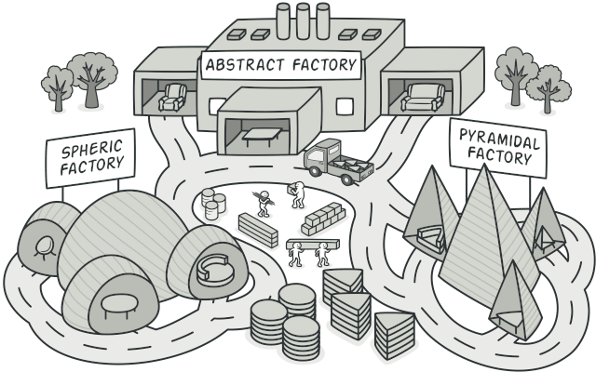
Abstract factory

Slide 23
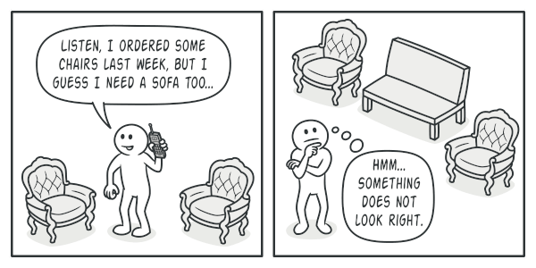
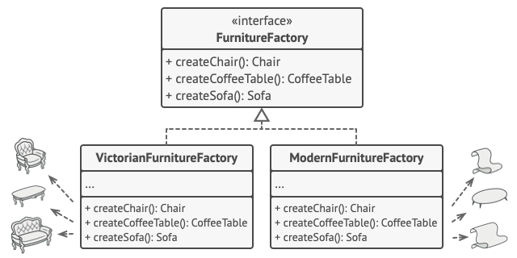
Abstract Factory is a creational design pattern that lets you produce families of related objects without specifying their concrete classes.

Slide 24
Implementation
Map out a matrix of distinct product types versus variants of these products.
Declare abstract product interfaces for all product types. Then make all concrete product classes implement these interfaces.
Declare the abstract factory interface with a set of creation methods for all abstract products.
Implement a set of concrete factory classes, one for each product variant.
Create factory initialization code somewhere in the app. It should instantiate one of the concrete factory classes, depending on the application configuration or the current environment. Pass this factory object to all classes that construct products.
Scan through the code and find all direct calls to product constructors. Replace them with calls to the appropriate creation method on the factory object.

Slide 25
Pros and cons
You can be sure that the products you’re getting from a factory are compatible with each other.
You avoid tight coupling between concrete products and client code.
Single Responsibility Principle. You can extract the product creation code into one place, making the code easier to support.
Open/Closed Principle. You can introduce new variants of products without breaking existing client code.
The code may become more complicated than it should be, since a lot of new interfaces and classes are introduced along with the pattern.

Slide 26
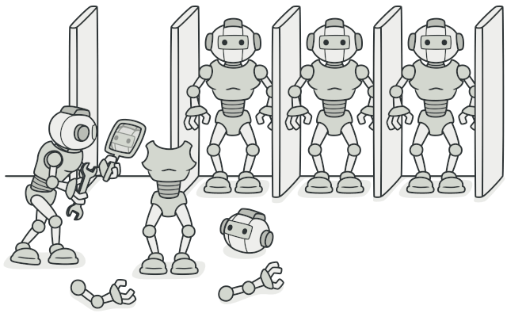
Prototype pattern

Slide 27

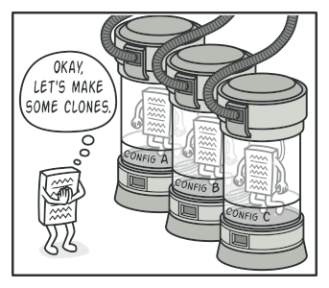
Prototype is a creational design pattern that lets you copy existing objects without making your code dependent on their classes.

Slide 28
Implementation
Create the prototype interface and declare the clone method in it. Or just add the method to all classes of an existing class hierarchy, if you have one.
A prototype class must define the alternative constructor that accepts an object of that class as an argument. The constructor must copy the values of all fields defined in the class from the passed object into the newly created instance. If you’re changing a subclass, you must call the parent constructor to let the superclass handle the cloning of its private fields.
The cloning method usually consists of just one line: running a new operator with the prototypical version of the constructor. Note, that every class must explicitly override the cloning method and use its own class name along with the new operator. Otherwise, the cloning method may produce an object of a parent class.

Slide 29
Pros and cons
You can clone objects without coupling to their concrete classes.
You can get rid of repeated initialization code in favour of cloning pre-built prototypes.
You can produce complex objects more conveniently.
You get an alternative to inheritance when dealing with configuration presets for complex objects.
Cloning complex objects that have circular references might be very tricky.

Slide 30
Structural design patterns

Slide 31
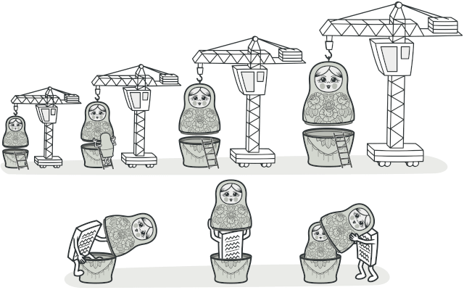
Decorator pattern

Slide 32
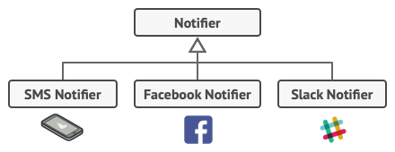
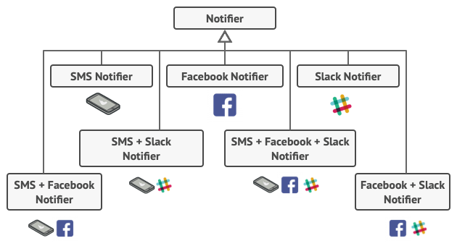
Decorator is a structural design pattern that lets you attach new behaviours to objects by placing these objects inside special wrapper objects that contain the behaviours.

Slide 33
Implementation
Create a concrete component class or interface and define the base behaviour in it.
Create a base decorator class. It should have a field for storing a reference to a wrapped object. The field should be declared with the component interface type to allow linking to concrete components as well as decorators. The base decorator must delegate all work to the wrapped object.
Make sure all classes implement the component interface.

Slide 34
Pros and cons
You can extend an object’s behaviour without making a new subclass.
You can add or remove responsibilities from an object at runtime.
You can combine several behaviours by wrapping an object into multiple decorators.
Single Responsibility Principle. You can divide a monolithic class that implements many possible variants of behaviour into several smaller classes.
It’s hard to remove a specific wrapper from the wrappers stack.
It’s hard to implement a decorator in such a way that its behaviour doesn’t depend on the order in the decorators stack.
The initial configuration code of layers might look pretty ugly.

Slide 35
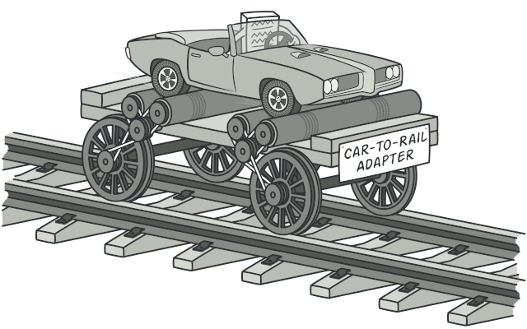
Adapter pattern

Slide 36
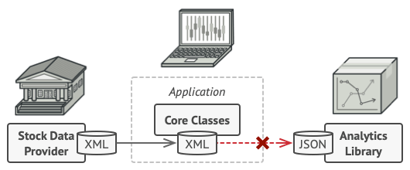
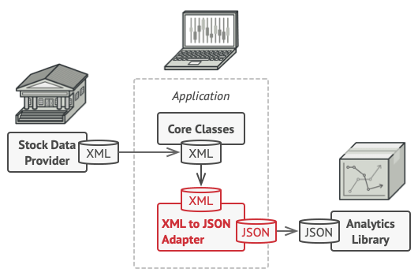
Adapter is a structural design pattern that allows objects with incompatible interfaces to collaborate.

Slide 37
Implementation
Declare the client interface and describe how clients communicate with the service.
Create the adapter class and make it follow the client interface. Leave all the methods empty for now.
Add a field to the adapter class to store a reference to the service object. The common practice is to initialize this field via the constructor, but sometimes it’s more convenient to pass it to the adapter when calling its methods.
One by one, implement all methods of the client interface in the adapter class. The adapter should delegate most of the real work to the service object, handling only the interface or data format conversion.

Slide 38
Pros and cons
Single Responsibility Principle. You can separate the interface or data conversion code from the primary business logic of the program.
Open/Closed Principle. You can introduce new types of adapters into the program without breaking the existing client code, as long as they work with the adapters through the client interface.
The overall complexity of the code increases because you need to introduce a set of new interfaces and classes. Sometimes it’s simpler just to change the service class so that it matches the rest of your code.

Slide 39
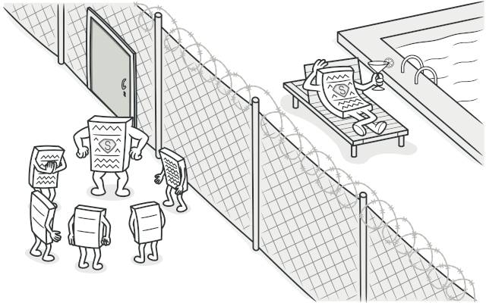
Proxy pattern

Slide 40
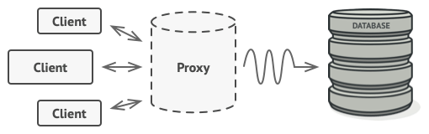
Proxy is a structural design pattern that lets you provide a substitute or placeholder for another object. A proxy controls access to the original object, allowing you to perform something either before or after the request gets through to the original object.

Slide 41
Implementation
If there’s no pre-existing service interface, create one to make proxy and service objects interchangeable. Extracting the interface from the service class isn’t always possible, because you’d need to change all of the service’s clients to use that interface. Plan B is to make the proxy a subclass of the service class, and this way it’ll inherit the interface of the service.
Create the proxy class. It should have a field for storing a reference to the service. Usually, proxies create and manage the whole life cycle of their services. On rare occasions, a service is passed to the proxy via a constructor by the client.
Implement the proxy methods according to their purposes. In most cases, after doing some work, the proxy should delegate the work to the service object.

Slide 42
Pros and cons
You can control the service object without clients knowing about it.
You can manage the lifecycle of the service object when clients don’t care about it.
The proxy works even if the service object isn’t ready or is not available.
Open/Closed Principle. You can introduce new proxies without changing the service or clients.
The code may become more complicated since you need to introduce a lot of new classes.
The response from the service might get delayed.

Slide 43
Behavioral design patterns

Slide 44
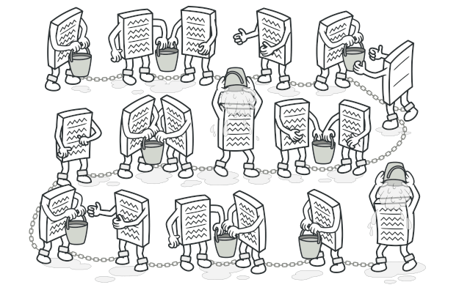
Chain of Responsibility pattern

Slide 45
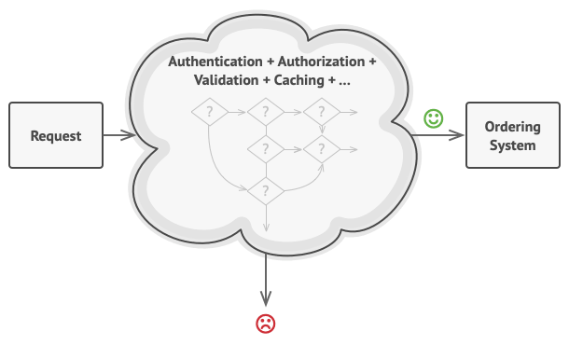
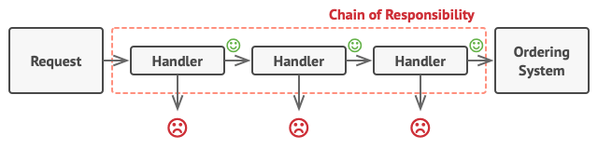
Chain of Responsibility is a behavioural design pattern that lets you pass requests along a chain of handlers. Upon receiving a request, each handler decides either to process the request or to pass it to the next handler in the chain.

Slide 46
Implementation
Declare the handler interface and describe the signature of a method for handling requests.
To eliminate duplicate boilerplate code in concrete handlers, it might be worth creating an abstract base handler class, derived from the handler interface.
One by one create concrete handler subclasses and implement their handling methods. Each handler should make two decisions when receiving a request:
Whether it’ll process the request.
Whether it’ll pass the request along the chain.
The client may either assemble chains on its own or receive pre-built chains from other objects. In the latter case, you must implement some factory classes to build chains according to the configuration or environment settings.

Slide 47
Pros and cons
You can control the order of request handling.
Single Responsibility Principle. You can decouple classes that invoke operations from classes that perform operations.
Open/Closed Principle. You can introduce new handlers into the app without breaking the existing client code.
Some requests may end up unhandled.

Slide 48
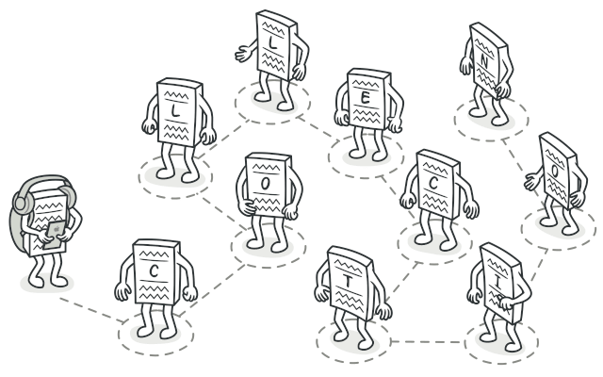
Iterator pattern

Slide 49
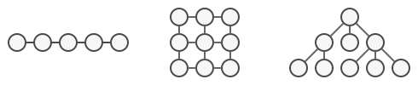
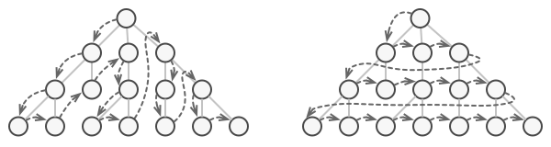
Iterator is a behavioural design pattern that lets you traverse elements of a collection without exposing its underlying representation (list, stack, tree, etc.).

Slide 50
Implementation
Declare the iterator interface. At the very least, it must have a method for fetching the next element from a collection. But for the sake of convenience you can add a couple of other methods, such as fetching the previous element, tracking the current position, and checking the end of the iteration.
Declare the collection interface and describe a method for fetching iterators. The return type should be equal to that of the iterator interface. You may declare similar methods if you plan to have several distinct groups of iterators.
Implement concrete iterator classes for the collections that you want to be traversable with iterators. An iterator object must be linked with a single collection instance. Usually, this link is established via the iterator’s constructor.
Go over the client code to replace all of the collection traversal code with the use of iterators. The client fetches a new iterator object each time it needs to iterate over the collection elements.

Slide 51
Pros and cons
Single Responsibility Principle. You can clean up the client code and the collections by extracting bulky traversal algorithms into separate classes.
Open/Closed Principle. You can implement new types of collections and iterators and pass them to existing code without breaking anything.
You can iterate over the same collection in parallel because each iterator object contains its own iteration state.
For the same reason, you can delay an iteration and continue it when needed.
Applying the pattern can be an overkill if your app only works with simple collections.
Using an iterator may be less efficient than going through elements of some specialized collections directly.

Slide 52
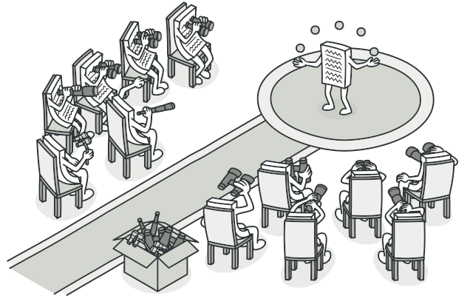
Observer pattern

Slide 53
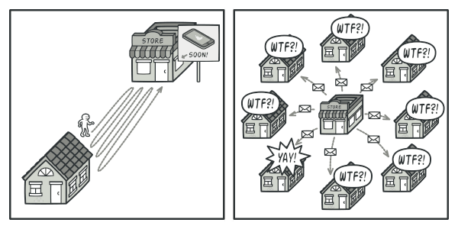
Observer is a behavioural design pattern that lets you define a subscription mechanism to notify multiple objects about any events that happen to the object they’re observing.

Slide 54
Implementation
Declare the subscriber interface. At a bare minimum, it should declare a single update method.
Declare the publisher interface and describe a pair of methods for adding a subscriber object to and removing it from the list. Remember that publishers must work with subscribers only via the subscriber interface.
Create concrete publisher classes. Each time something important happens inside a publisher, it must notify all its subscribers.
Implement the update notification methods in concrete subscriber classes. Most subscribers would need some context data about the event. It can be passed as an argument of the notification method.

Slide 55
Pros and cons
Open/Closed Principle. You can introduce new subscriber classes without having to change the publisher’s code (and vice versa if there’s a publisher interface).
You can establish relations between objects at runtime.
Subscribers are notified in random order.

Slide 56
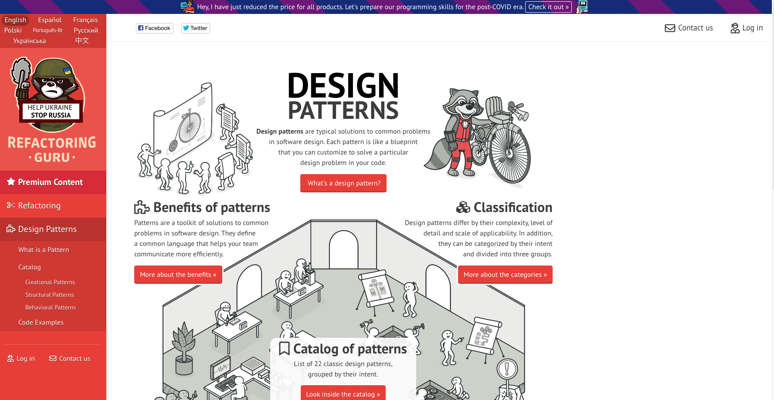

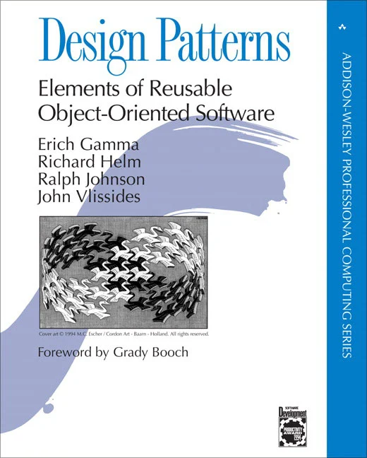
Useful resources

Slide 57
Q&A

Slide 58
Thank you.
Razvan-Costin Balasa
Senior Consultant
Contact: rbalasa@deloittece.com

